Slide 1
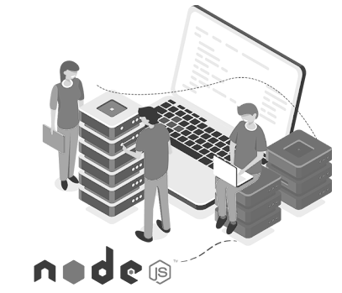

BACK-END DEVELOPMENT
WEEK 4 – REST API Design + Modular Express

Slide 2
After Finishing This Lecture:
Understand REST principles
Design clean API routes
Modularize Express apps from top (entry point) to bottom (features)
Learn to build a modular Express server
Identify good REST API design patterns
Apply top-down architecture to Node.js projects

Slide 3

What is an API?
API (Application Programming Interface) is a set of rules that allows two software applications to communicate with each other.
Acts as a messenger between systems.
Hides internal implementation details, exposing only what’s necessary.
Can be public (e.g., Twitter API), private, or partner-only.

Slide 4
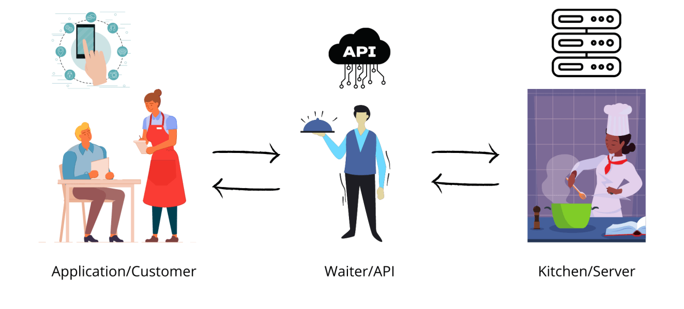
What is an API? (Cont)
Real-World Analogy:
A restaurant menu is like an API:
You (the client) use the menu to request food.
The kitchen (the server) prepares it without you knowing how.
The waiter (API) delivers the result.

Slide 5
What is REST?
REST = Representational State Transfer
Coined by Roy Fielding in his 2000 Ph.D. dissertation
A design pattern or architectural style for building scalable web services
REST uses standard HTTP methods to perform operations on resources, which are identified by URLs.

Slide 6
Core REST Concepts
Term | Meaning
Resource | Any object or data entity (e.g., user, post, product)
Representation | A format to represent the resource (typically JSON)
State Transfer | Client sends and receives the current state of the resource

Slide 7
Example Resource
GET /posts/123 – Retrieve a specific post
{
"id": 123,
"title": "What is REST?",
"content": "REST stands for Representational State Transfer..."
}
POST /posts/ – Create a new post
POST /posts
Content-Type: application/json
{
"title": "Understanding HTTP Methods",
"content": "Let's learn about GET, POST, PUT, and DELETE..."
}

Slide 8
HTTP Methods
Method | Action | Description
GET | Read | Fetch a resource
POST | Create | Add a new resource
PUT | Update | Replace an existing resource
PATCH | Partial Update | Modify part of a resource
DELETE | Delete | Remove a resource

Slide 9
Key REST Concepts
Resource A resource represents a logical data entity. Each resource is identified by a URI and manipulated using standard HTTP methods.
Examples:
User: Represents a person using your app
Post: A blog article or comment

Slide 10
Key REST Concepts
URI (Uniform Resource Identifier) URI is the address used to access resources. RESTful APIs use URIs to uniquely identify resources.
Examples:
GET /api/users – list of users
GET /api/posts/123 – a specific post with ID 123

Slide 11
Key REST Concepts
Stateless Each request from a client to the server must contain all necessary information to process it. The server does not retain any session state between requests.
Implications:
Improves scalability
Makes APIs easier to debug and cache

Slide 12
Key REST Concepts
Representation A resource can have multiple representations (e.g., JSON, XML). Clients interact with the representation, not the actual resource.
Most Common: JSON (JavaScript Object Notation)
{
"id": 123,
"title": "REST Basics",
"author": "Alice"
}

Slide 13
RESTful Endpoint Design
Use Plural Nouns for Routes
Resources should be treated as collections.
Stick to nouns, not verbs.
Why? It reflects REST’s resource-oriented architecture.
HTTP Verb | Endpoint | Description
GET | /api/posts | Get all blog posts
GET | /api/posts/:id | Get a single post by ID
POST | /api/posts | Create a new blog post
PATCH | /api/posts/:id | Update an existing post
DELETE | /api/posts/:id | Delete a post

Slide 14
RESTful Endpoint Design
Avoid Verbs in the URI
Bad:
/api/getPosts
/api/createPost
Good:
Use HTTP methods to convey actions:
GET /api/posts (not /getPosts)
POST /api/posts (not /createPost)

Slide 15
RESTful Endpoint Design
Sub-resources / Nested Resources
For relationships between resources:
GET /api/posts/123/comments – Comments on post #123
POST /api/posts/123/comments – Add comment to post #123

Slide 16
HTTP Status Codes
HTTP status codes are 3-digit responses sent by the server to indicate the result of a client's request.
Success Codes
200 OK – Request succeeded Example: Successfully retrieved a list of posts with GET /api/posts
201 Created – Resource was successfully created Example: A new post was created with
POST /api/posts

Slide 17
HTTP Status Codes
Client Error Codes
400 Bad Request – The request is malformed or missing required data Example: Missing title field in POST /api/posts
401 Unauthorized – Client must authenticate before accessing the resource Example: Accessing a protected route without a valid token
404 Not Found – The requested resource does not exist Example: GET /api/posts/9999 when post ID 9999 doesn't exist
Server Error Code
500 Internal Server Error – Something went wrong on the server Example: An unexpected exception or database crash

Slide 18
Traditional Express Setup
One File = All Logic
Typical beginners write everything in a single file: server.js
Routes, middleware, controllers, and DB logic are all jammed together
Problems with This Approach:
Hard to maintain: Adding new features becomes messy
No separation of concerns: Logic for different parts of the app is mixed
Difficult to test: You can’t easily isolate logic
Poor scalability: Hard to onboard new developers or grow the codebase

Slide 19
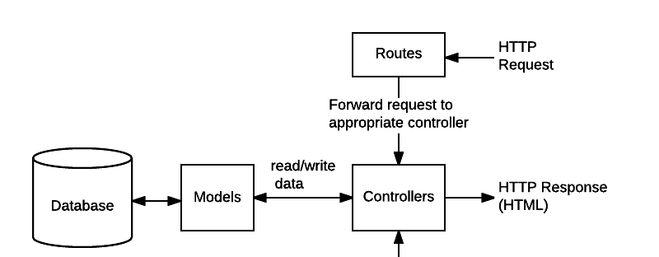
Separation of Concern
Each layer handles a single responsibility:
Routes: Handle URLs and method mapping
Controllers: Handle request/response logic
Models: Handle data interaction
Cleaner and more understandable code
Sample Source Code: https://github.com/KimangKhenng/express-separate

Slide 20
Additional Reading
Rest API Design Guideline: https://restfulapi.net/
Sample Rest API Design: https://petstore.swagger.io

Slide 21
Questions
Q1: Can I return HTML from a REST API?
Q2: What’s the role of models if I’m not using a database yet?
Q3: How should I name nested resources?

Slide 22
Answers
A1: Technically yes, but REST APIs usually return JSON. Returning HTML is more typical in traditional server-rendered web apps.
A2: You can still define mock data or schema structure to simulate interactions and prepare for later DB integration.
A3: Use logical nesting, e.g.: GET /api/posts/:postId/comments This shows that comments belong to a specific post.

Slide 23

WHAT WE HAVE LEARNT
Understand REST principles
Design clean API routes
Modularize Express apps from top (entry point) to bottom (features)
Learn to build a modular Express server
Identify good REST API design patterns
Apply top-down architecture to Node.js projects

